Slide 1
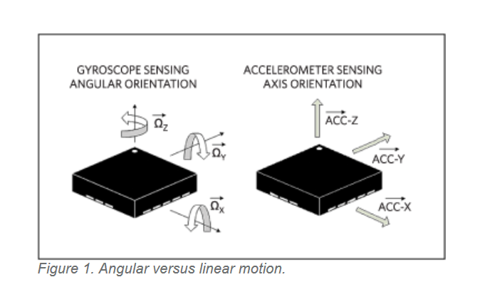
PROPOSED SOLUTION
The vibrations and accelerations of the senior citizen while they are sleeping, moving or doing some work are given to our model as an input.
Based on their vibrations and acceleration our model will predict whether the person is fallen or not.
If the person has fallen it will also say in which position the person has fallen and he had recovered after falling or not, this is done with the help of Gyroscope which is integrated with the Accelerometer.

Slide 2
Classification based on time series data:
WORKFLOW
TIME SERIES DATA :
The accelerometer sensor should be worn by senior citizens. It gives the acceleration, vibrations and many other features that are given as input to our model.
An additional sensor i.e Gyroscope is integrated with the accelerometer, it says the orientation of the person.
As the data from these sensors is time series data, based on this data we can also say if the person has recovered from the accident.
For time series data classification we use one of the recently developed algorithm i.e, Recurrent Neural Networks (RNNs). RNNs are considered to be good for time series data.
As we have to predict whether the person is fallen or not, in machine learning terminology the problem is considered to be a binary classifier. If fallen, we have to notify the family members of the person immediately.

Slide 3
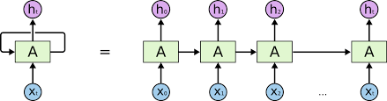
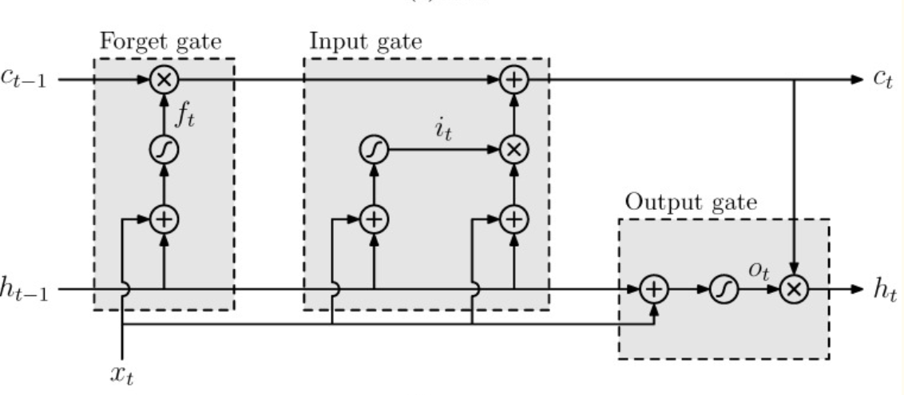
TECHNOLOGY STACK
It consists of an Accelerometer integrated with Gyroscope, and the algorithm we are using is Recurrent Neural Network.
Generally, in Recurrent Neural Networks, there is a drawback of exploding and vanishing gradient but our model will overcome this drawback as we are using one of the best and traditional architectures of RNN i.e, Long Short Term Memory(LSTM).
We are using a technique called Gradient Clipping which will prevent the RNN from exploding gradient.
RNN Architecture
LSTM Architecture

Slide 4
USE CASES
Falls are one of the most dangerous and frequently caused accidents for the elderly. As it can cause great damage which usually leads to dangerous injuries. It is extremely important to inform the family members or near and dear ones in order to get the first aid as quickly as possible.
Speaking of response time, our proposed system will give an emergency message to family members within 2 seconds of the accident.
DEPENDENCIES
Data set: By training our model with 300 elderly people data by accelerometer we are noticing sound results. However, to bring the solution to production level our model requires a large dataset.
As per the hardware requirements: An Accelerometer integrated with a Gyroscope and a General Computer with modern standards.

